Slide 1
RDF Validation requirements DB
DC 2014
Thomas Bosch
thomas.bosch@gesis.org
boschthomas.blogspot.com
https://github.com/boschthomas
Notes:
Sources
2013 W3C RDF Validation Workshop
2013 Semantic Web in Libraries Conference
DC WG on RDF APs
W3C WG on RDF Validation
Outline
-----
What is RDF validation?
RDF validation requirements DB (DB URL, idea, sources)
From a Case Study to a Solution (and Back))
requirements classification
Present different requirements which are validated using constraints
How to formulate constraints
No one-size-fits-all solution
using different solutions covering different requirements
How to contribute? [Live demo]
tagging as relevant for specific domain
DC case studies, use cases, and requirements (e.g. DM2E, Europeana)
requirements classification

Slide 2

from a case study
to a solution

Slide 3
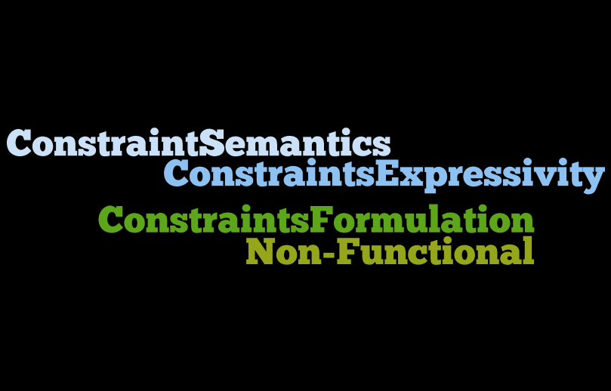
requirements
classification

Slide 4
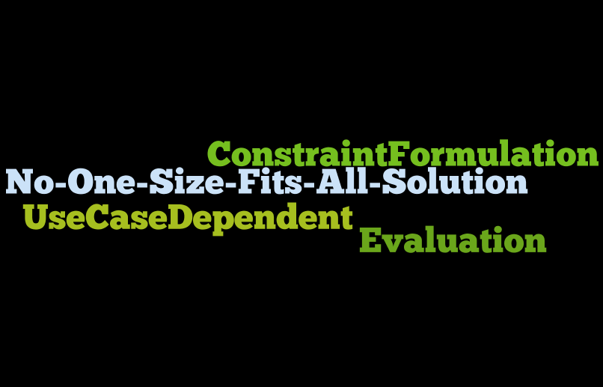
evaluation
Notes:
no one-size-fits-all solution
Different use cases are covered differently by different solutioons
Choose solution which fits best for specific use cases

Slide 5
R-68-REQUIRED-PROPERTIES
Bibframe, DQTP, DSP, OWL 2, ReSh, ShEx, SPIN, SPARQL

Slide 6
valid data
:dcmi
a :Organization ;
:name "Dublin Core Metadata Initiative" .

Slide 7
constraint (DSP)
:organizationDescriptionTemplate
a dsp:DescriptionTemplate ;
dsp:minOccur 1 ;
dsp:maxOccur "infinity" ;
dsp:resourceClass :Organization ;
dsp:statementTemplate [
a dsp:NonLiteralStatementTemplate;
dsp:minOccur 1 ;
dsp:maxOccur "infinity" ;
dsp:property :name ] .

Slide 8
invalid data
:dcmi
a :Organization .

Slide 9
constraint (OWL2)
:Organization
rdfs:subClassOf [
a owl:Restriction ;
owl:minCardinality 1 ;
owl:onProperty :name ] .

Slide 10
validation
validator
purl.org/net/rdfval-demo
executable examples
R-68-REQUIRED-PROPERTIES

Slide 11
how to contribute?
RDF validation database
purl.org/net/rdf-validation
Notes:
Domain-specific tagging

Slide 12
R-13-DISJOINT-GROUP-OF-PROPERTIES-CLASS-SPECIFIC
ShEx, SPIN, SPARQL

Slide 13
constraint
<Human> {
(
foaf:name xsd:string
|
foaf:givenName xsd:string+ ,
foaf:familyName xsd:string
)
}

Slide 14
matching
'Human' shape
:Luke
foaf:givenName "Luke" ;
foaf:familyName "Skywalker" .
:Leia
foaf:name "Leia Skywalker" .

Slide 15
NOT matching
'Human' shape
:Anakin
foaf:givenName "Anakin" ;
foaf:familyName "Skywalker" ;
foaf:name "Anakin Skywalker" .

Slide 16
validation
validator
www.w3.org/2013/ShEx/FancyShExDemo
executable examples
R-13-DISJOINT-GROUP-OF-PROPERTIES-CLASS-SPECIFIC

Slide 17
how to contribute?
RDF validation database
purl.org/net/rdf-validation
Notes:
Domain-specific tagging

